Slide 1
CSCI 499 Senior Project The Bingo App
Christopher Bell April 15, 2020

Slide 2
Introduction:
What is it? – A Simple Bingo App
Who is it built for? – People like me.
Why was it built? – For enjoyment and entertainment when you can’t play with anyone.
I want to create an application that lets you play bingo with yourself and not have to worry about finding other people to play with or an internet connection.

Slide 3
Research/Background
What already existed?
What do I need to put in there?
Equipment Needed:
A working up-to-date Java environment
Laptop or Desktop Computer

Slide 4
Game Break

Slide 5
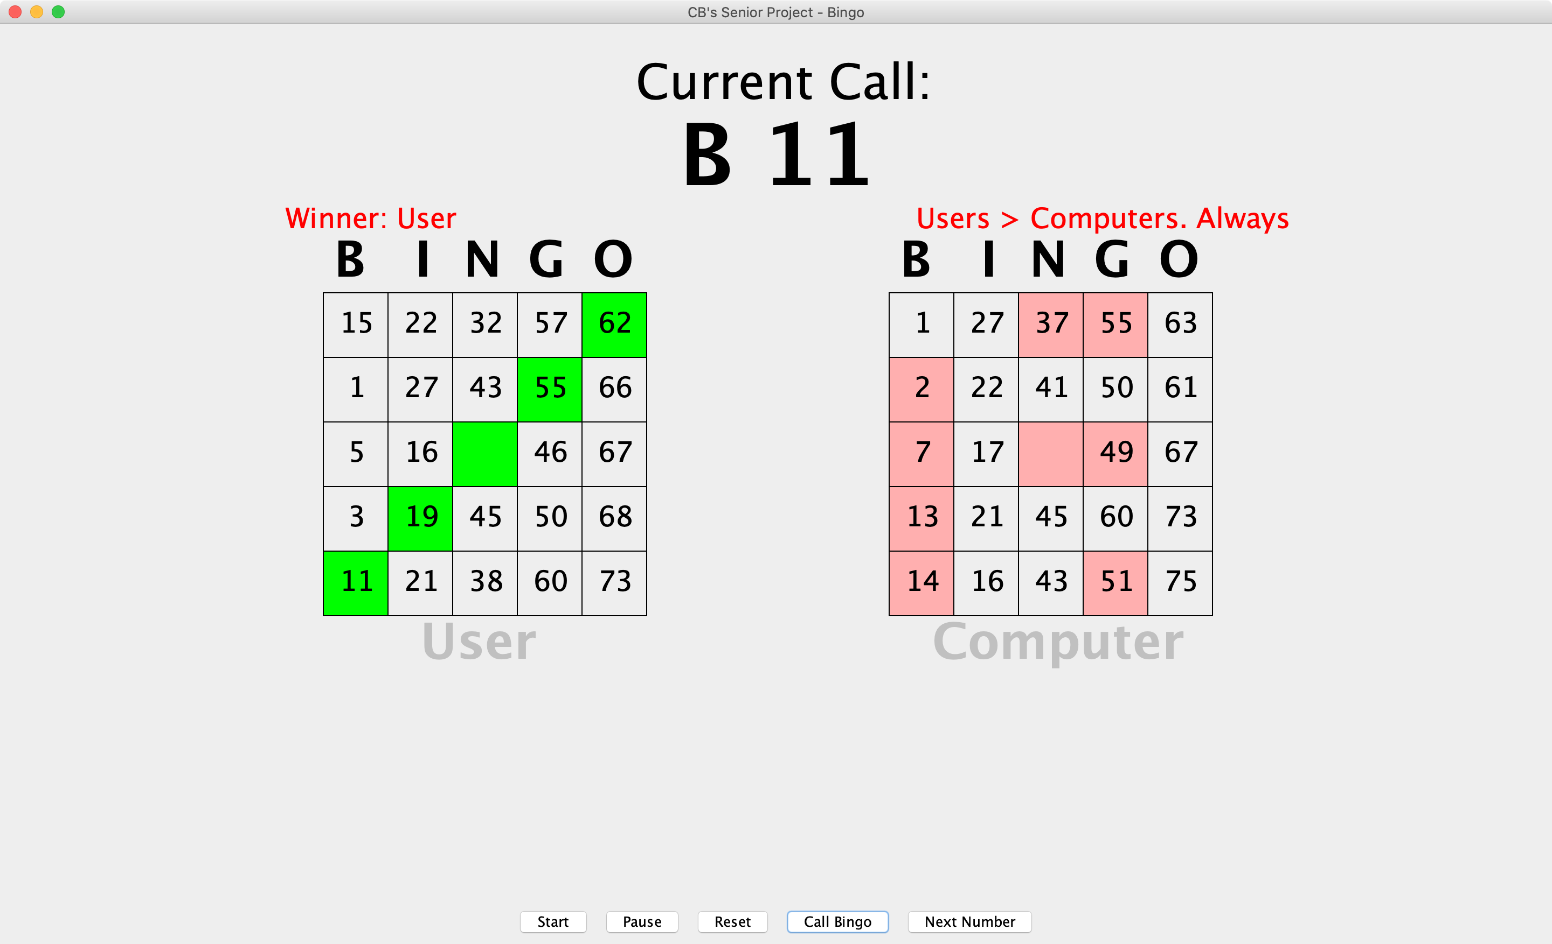
Review of the game

Slide 6
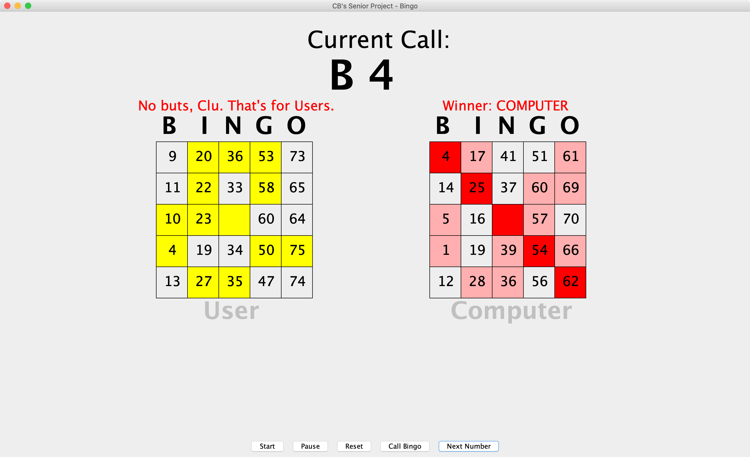
Review of the game

Slide 7
Features
Main Features:
Board Auto-generation
Rolling, random number/letter generator
“Legal Bingo” analyzer
User friendly buttons/prompts to guide them how to play
Most Difficult Piece: Random Generator
Random, but not random
Calling them and then being able to scan them later when bingo is called

Slide 8
Testing and Setbacks
Testing:
I played roughly 300 games of Bingo over the last year and half (130 complete)
Setbacks include:
Loosing all my original files
Certain functions weren’t working as intended and needed to be redone from the ground up
Time and physical restraints due to sickness and other unforeseeable events

Slide 9
Future Additions
An additional version that lets you play with music clips and titles
A call history that lists what has been shown
An optional multiplayer version that could be in person or over network
A choice of color dauber

